Slide 1
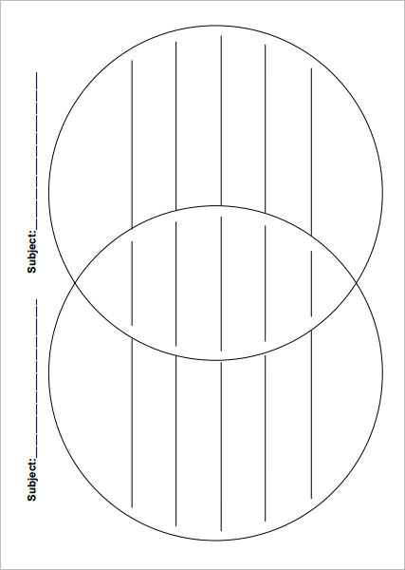
Mitosis/Meiosis Homework Name _______________
Complete the Venn diagram with similarities and differences between mitosis and meiosis.

